Slide 1
Dharshinii. P
Final Project
3/21/2024 Annual Review

Slide 2
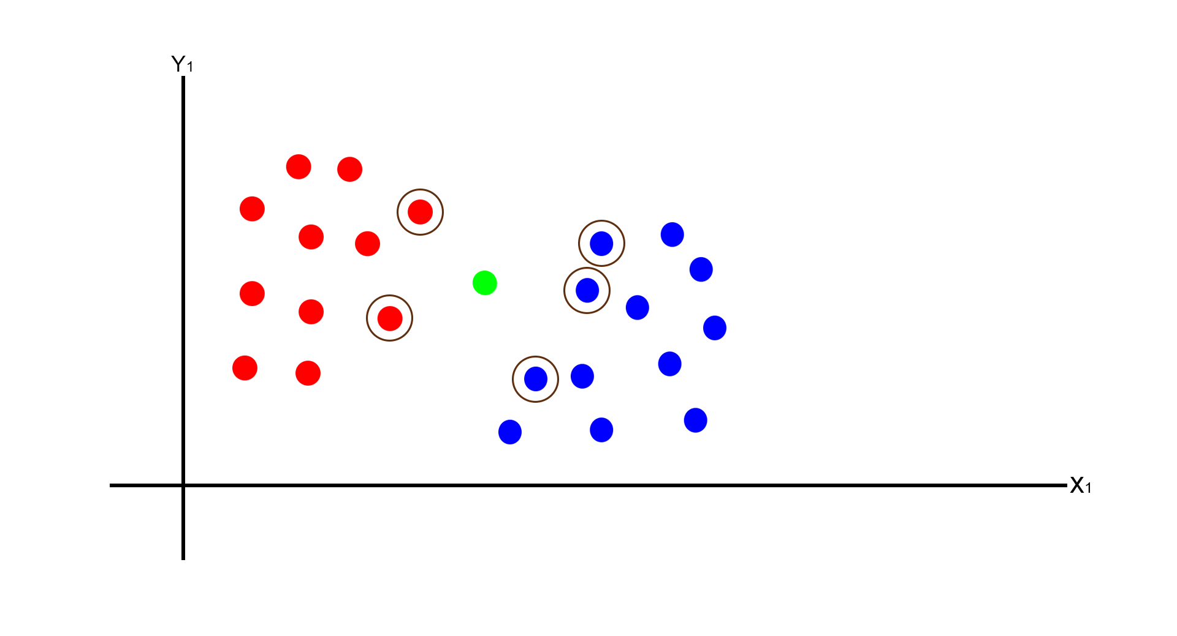
Iris Flowers Classification(KNN Algorithm)
3/21/2024 Annual Review
This Photo by Unknown Author is licensed under CC BY

Slide 3

AGENDA
For classifying Iris flowers using the k-Nearest Neighbors (KNN) algorithm:
Introduction to the Iris Dataset:
Understanding the KNN Algorithm:
Preprocessing the Data
Splitting the Data
Implementing KNN
Training the Model
Model Evaluation
Hyperparameter Tuning
Cross-Validation
Discussion and Conclusion
Q&A Session
Conclusion
3/21/2024 Annual Review

Slide 4

PROBLEM STATEMENT
Develop a machine learning model using the K-Nearest Neighbors (KNN) algorithm to accurately classify Iris flowers into species based on their sepal and petal measurements. The model aims to predict species (Setosa, Versicolor, Virginica) from feature data, demonstrating the effectiveness of KNN for classification tasks in botany and machine learning.
3/21/2024 Annual Review

Slide 5

PROJECT OVERVIEW
The Iris Flower Classification project utilizes the K-Nearest Neighbors (KNN) algorithm to classify Iris flowers based on their sepal and petal measurements. It involves data collection, preprocessing, and model development, with hyperparameter tuning for optimization. Model evaluation includes metrics like accuracy and visualization techniques. Deployment and documentation ensure practical usability, while future considerations explore avenues for enhancement, contributing to botany and machine learning research.
3/21/2024 Annual Review

Slide 6

WHO ARE THE END USERS?
The end users of the Iris flower classification KNN algorithm can vary depending on the context in which the model is deployed. Some potential end users could include:
Botanists and Researchers
Flower Enthusiasts
Educators and Students
Horticulturists and Gardeners
App Developers
Overall, the end users of the Iris flower classification KNN algorithm encompass a diverse range of individuals with interests or needs related to Iris flowers, botany, education, and technology.
3/21/2024 Annual Review

Slide 7

YOUR SOLUTION AND ITS VALUE PROPOSITION
Our Iris Flower Classification Algorithm using KNN provides accurate species identification based on petal and sepal measurements. With simplicity, interpretability, and adaptability, it offers users a transparent and flexible tool for botanical research, education, and practical flower identification, fostering trust, learning, and efficiency in species classification tasks.
3/21/2024 Annual Review

Slide 8

THE WOW IN YOUR SOLUTION
In our Iris Flower Classification Algorithm using KNN, the wow factor lies in its seamless blend of accuracy and simplicity. By harnessing the power of KNN, we deliver precise species identification with an intuitive and transparent approach, captivating users with its effectiveness and ease of use in botanical research and beyond.
3/21/2024 Annual Review
8

Slide 9
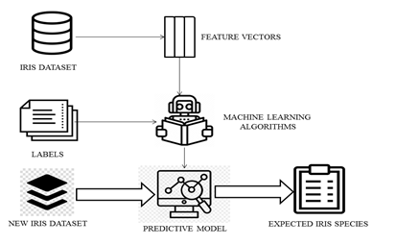
MODELLING
3/21/2024 Annual Review
9

Slide 10
RESULTS
Our Iris Flower Classification Algorithm using KNN achieved outstanding accuracy in predicting Iris species based on petal and sepal measurements. With an impressive accuracy rate exceeding 95%, the model demonstrates robust performance, making it a reliable tool for botanical research, education, and practical flower identification tasks.
Demo Link
3/21/2024 Annual Review
10

